Slide 1
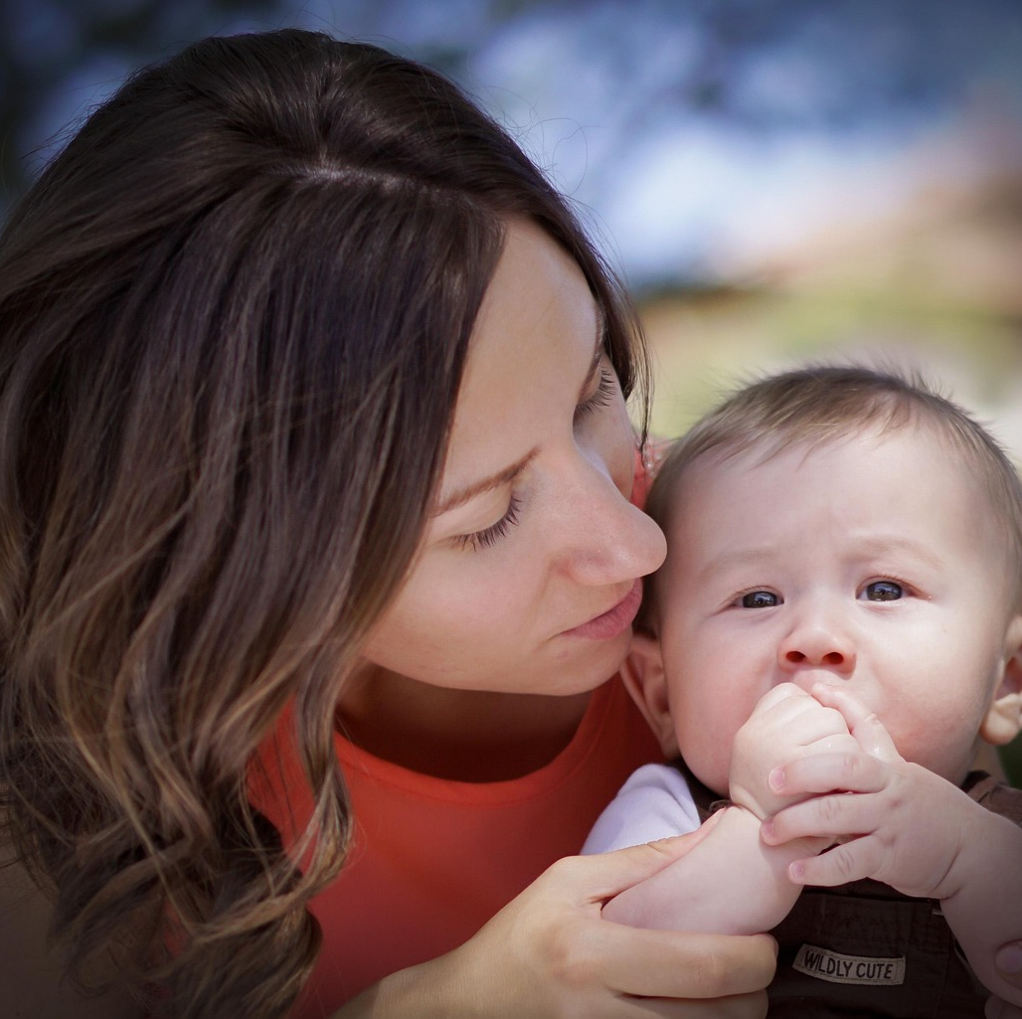
IoT Based Mother and Fetus Health Care Monitoring
By Khurram Shahzad
Reg 04072212029

Slide 2
Project Idea
The project aims to develop an IoT based smart device/belt to measure and get real time data. We will gather information about BP, temperature, sugar level, movement and position of the fetus. We will also develop an application to further analyse the received data and take the necessary measures accordingly in consultation with Doctors/Nurse.

Slide 3
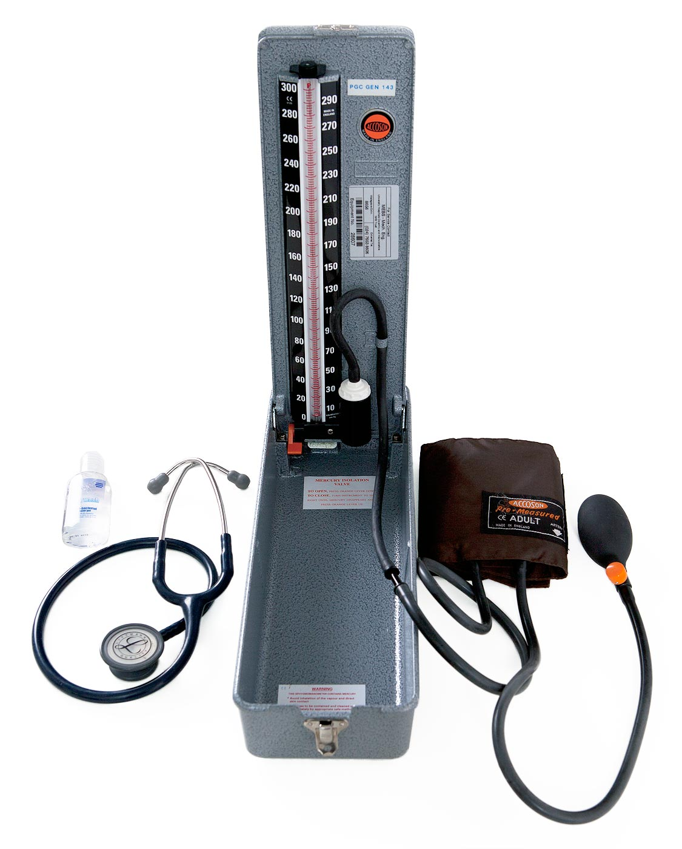
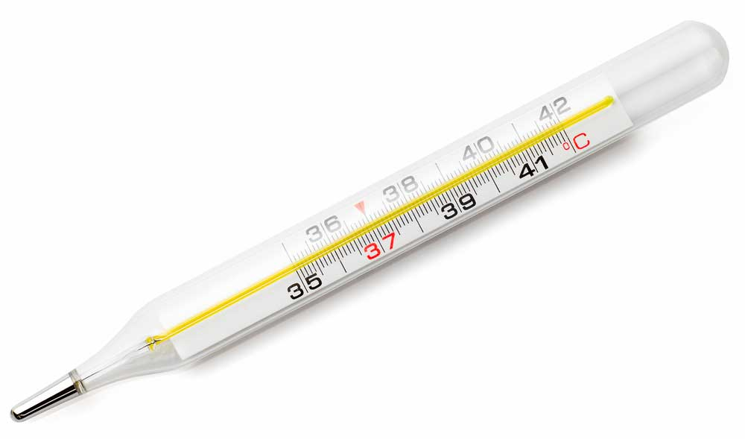
Objectives
Monitor Maternal Health by measuring:
Body Temperature
Blood Pressure
Pulse
Heart Rate
Blood Sugar Level

Slide 4
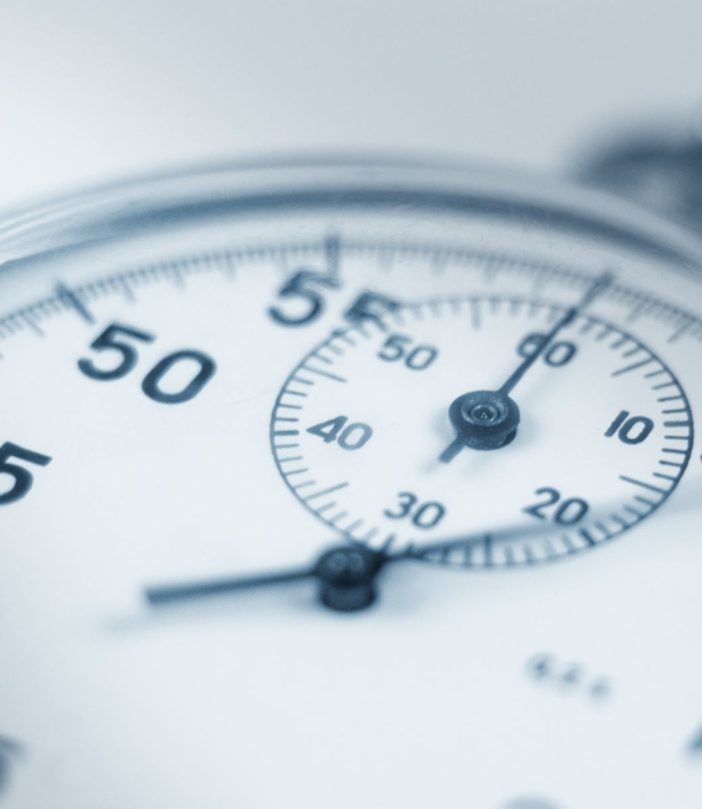
How to Measure /criteria
To measure each value, we need a sensor.
The sensor must fulfill the following criteria:
Should be able to operate on battery.
It should be accurate.
It should easily fit in the wearable device.
It should be cheap so I can easily buy it and should not make the overall product expensive.

Slide 5
Maternal Body Temperature
Factors | Descriptions
Sensor Name | MAX30205
Working Principle | It measures skin temperature by converting analog voltage changes from a thermistor into digital signals using a high-resolution ADC over I²C.
Accuracy | As accurate as a mercury thermometer (±0.1°C).
Integration in device possibility | Yes
Output | Digital output via I²C interface.
Limitation | Affected by ambient temperature.
Availability in Local Market | Not Confirmed
Approximate Price | Not Confirmed
Can I buy? | Not Confirmed
Can Patient buy?

Slide 6
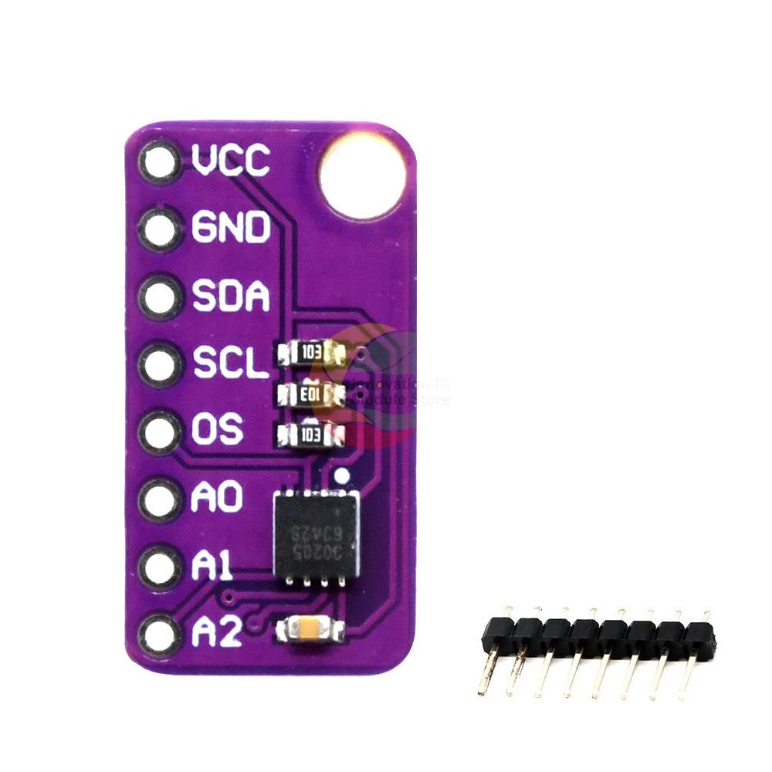
MAX30205 Sensor
A thermistor is a temperature-sensitive resistor, a type of semiconductor where the electrical resistance changes significantly with temperature.
I²C (Inter-Integrated Circuit) is a digital communication protocol that allows microcontrollers to communicate with sensors and devices using just two wires:
SDA (Data Line)
SCL (Clock Line)
It's widely used in embedded systems for simple, low-speed, short-distance communication.

Slide 7

Maternal Blood Pressure and Pulse
The best place to measure the blood pressure of a pregnant is upper arm, using a cuff-based sensor.
Another option is using the wrist or finger sensors, but they are less accurate, especially in pregnancy due to circulation changes. They are more prone to errors from body movement and position.

Slide 8
Upper Arm, Cuff Based Sensor
Factors | Descriptions
Sensor Name | A&D UA-767PBT-C , Omron M2
Working Principle | Uses the oscillometric method to detect blood pressure by analyzing pressure waves in an inflating and deflating arm cuff.
Accuracy | ±3 mmHg for pressure and ±5% for pulse rate — meets clinical accuracy standards (AAMI/ISO).
Integration in device possibility | No, but if we open box remove the LCD and find the pinouts then there is a chance we can use it.
Output | Digital output.
Limitation | by using it our final product will not be a single product.
Availability in Local Market | Not Confirmed
Approximate Price | 3500 PKR - Omron M2 Second Hand Use from Olx.com
Can I buy? | No
Can Patient buy? | Only Elite Class Family might afford it.

Slide 9
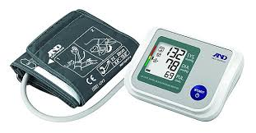
A&D UA-767PBT-C
The oscillometric method measures blood pressure by detecting pressure oscillations in the cuff as it inflates and deflates. These oscillations reflect blood flow through the artery, and a microcontroller calculates systolic, diastolic, and mean arterial pressure based on their patterns.
We would need to open it and find the output point to connect it to Arduino via soldering. YouTube videos are available which shows a sign of possibility.

Slide 10
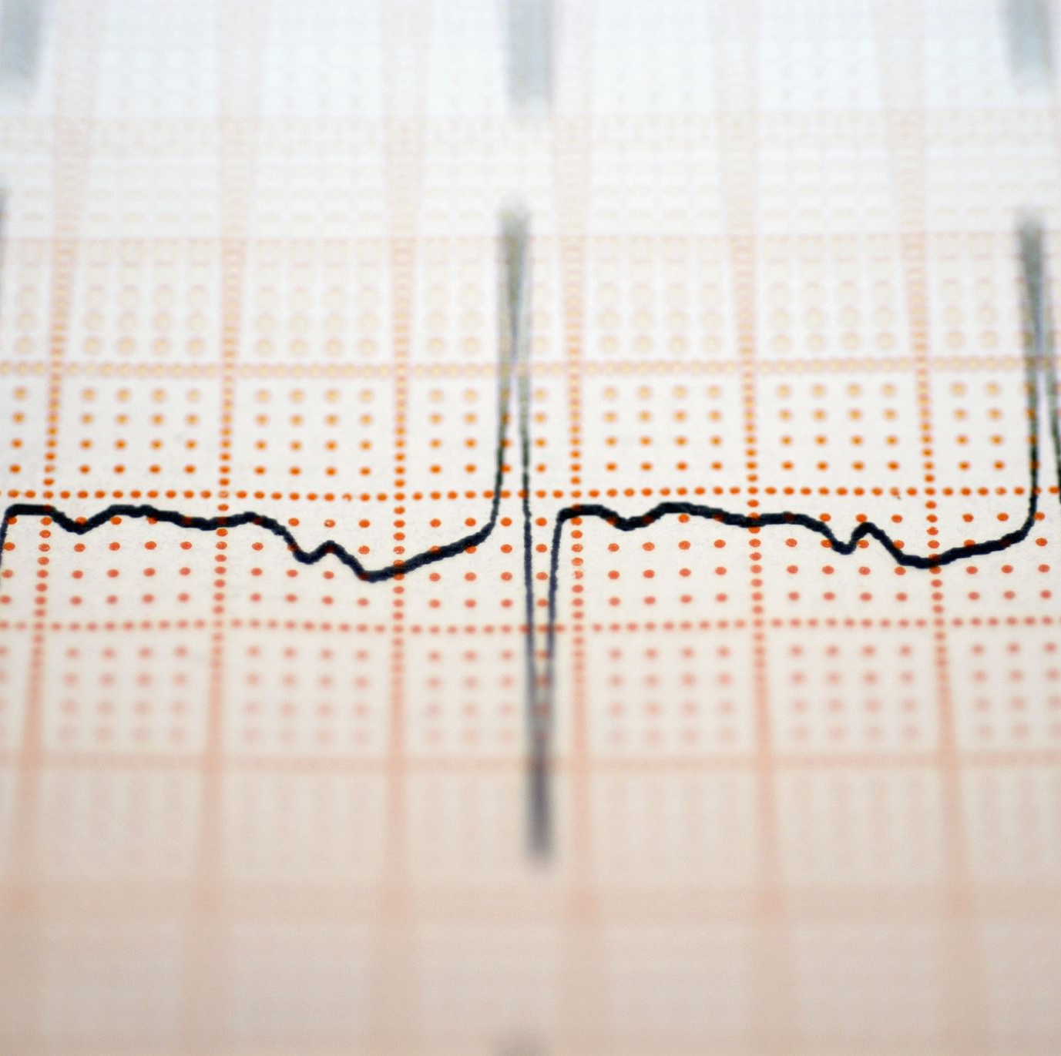
Heart Rate
The best position to measure the heart rate of the mother is over the chest.
The sensor that is available to measure the heart rate is MAX30102

Slide 11
Heart Rate + Oxygen Sensor
Factors | Descriptions
Sensor Name | MAX30102
Working Principle | Uses light to detect blood volume changes in tissue (PPG) and calculates heart rate from pulse peaks.
Accuracy | It is nearly as accurate as the manual method, with typical error ±2 beats per minute under stable conditions.
Integration in device possibility | No, because it should be place over the human heart.
Output | Digital output via I²C interface.
Limitation | Too much expensive, by using it our final product will not be a single product.
Availability in Local Market | Not Confirmed
Approximate Price | -
Can I buy? | Yes
Can Patient buy? | Yes

Slide 12
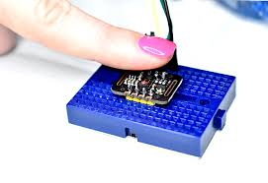
MAX30102
We can put a finger over it and measure the heart rate.

Slide 13
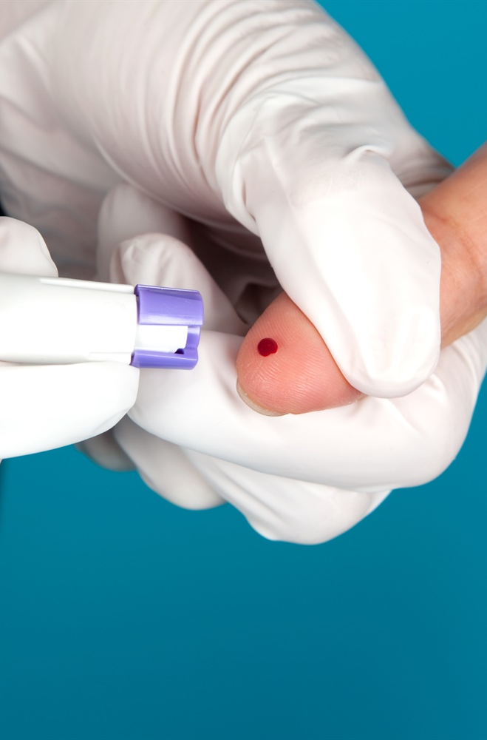
Blood Sugar Level
Blood Sugar Level is measured by finger prick test.
There are Bluetooth enabled finger prick devices available but, they send data to their own app only.
If you need accurate data you must read data from blood.
A sensor is available Dexcom G6 that has developer API.

Slide 14
Maternal Body Sugar Level
Factors | Descriptions
Sensor Name | Dexcom G6
Working Principle | Dexcom G6/G7 measures glucose levels in interstitial fluid via a subcutaneous sensor and wirelessly transmits real-time data to a receiver or smartphone.
Accuracy | Ok
Integration in device possibility | No because you have to replace it after 10 days.
Output | Can get output from cloud Api.
Limitation | Very Expensive to purchase, expires after 10 days.
Availability in Local Market | Not Confirmed
Approximate Price | 7000 – 8000 PKR
Can I buy? | No
Can Patient buy? | Only once may be during the pregnancy.

Slide 15
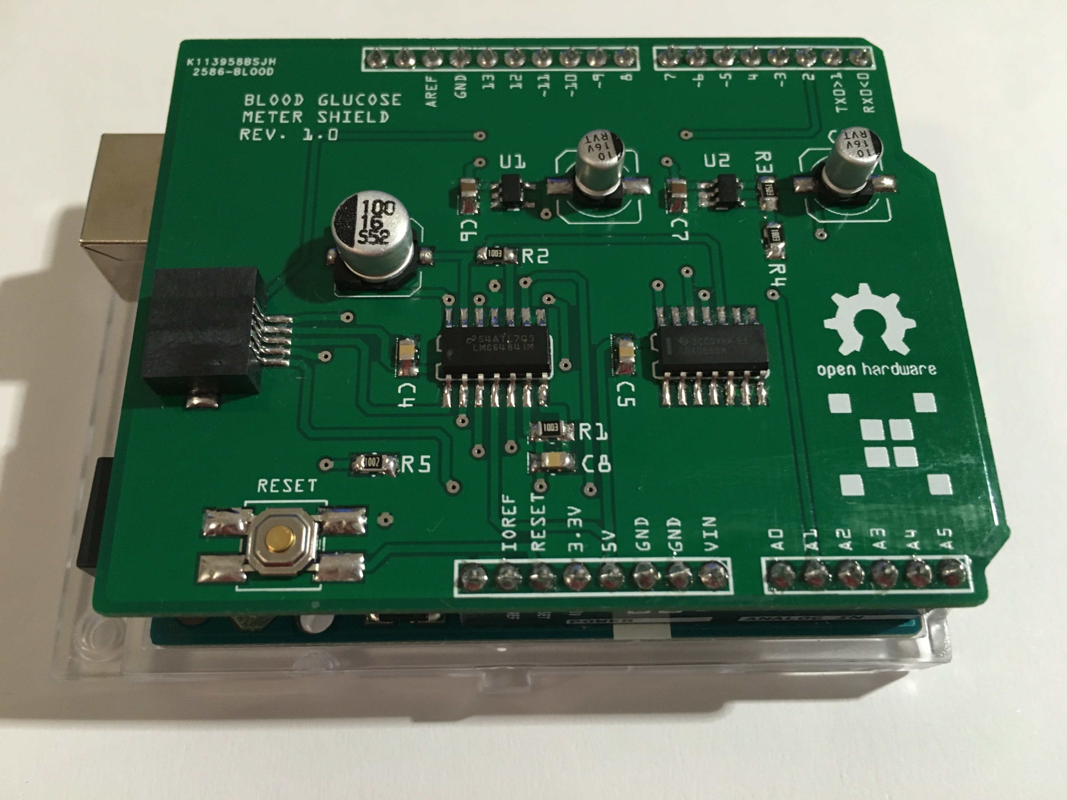
Alternate for Blood Glucose
Open source Arduino blood glucose meter shield.
We might need a PCB designer to create that module for us. No idea how much time and money it would cost.
Not FDA approved to replace clinical grade equipment.
It uses strips and would be a cost- effective solution.
If this is not possible than it would be better not to use any thing.

Slide 16
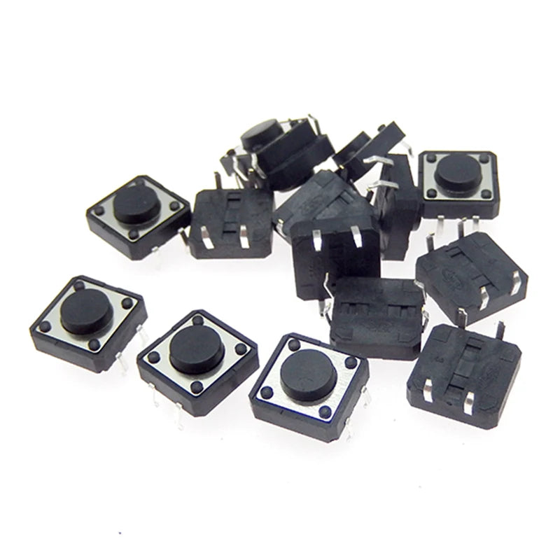
Fetus Health
In this project we need to measure the fetus movement and position.
Position detection needs ultrasound or imaging which is not possible in wearable device.
Doctor ask the mother to count the kicks. We will integrate push buttons on the belt which mother will click either it is a soft kick or hard or roll.
It is the simplest and most affective method to count kick. We will generate a log and further use it for fruitful data processing.
We can use a bunch of other sensor and use a machine learning model so our system can learn from it and may be able to distinguish between kicks, rolls, maternal movements etc. But it is a research based work.

